Slide 1
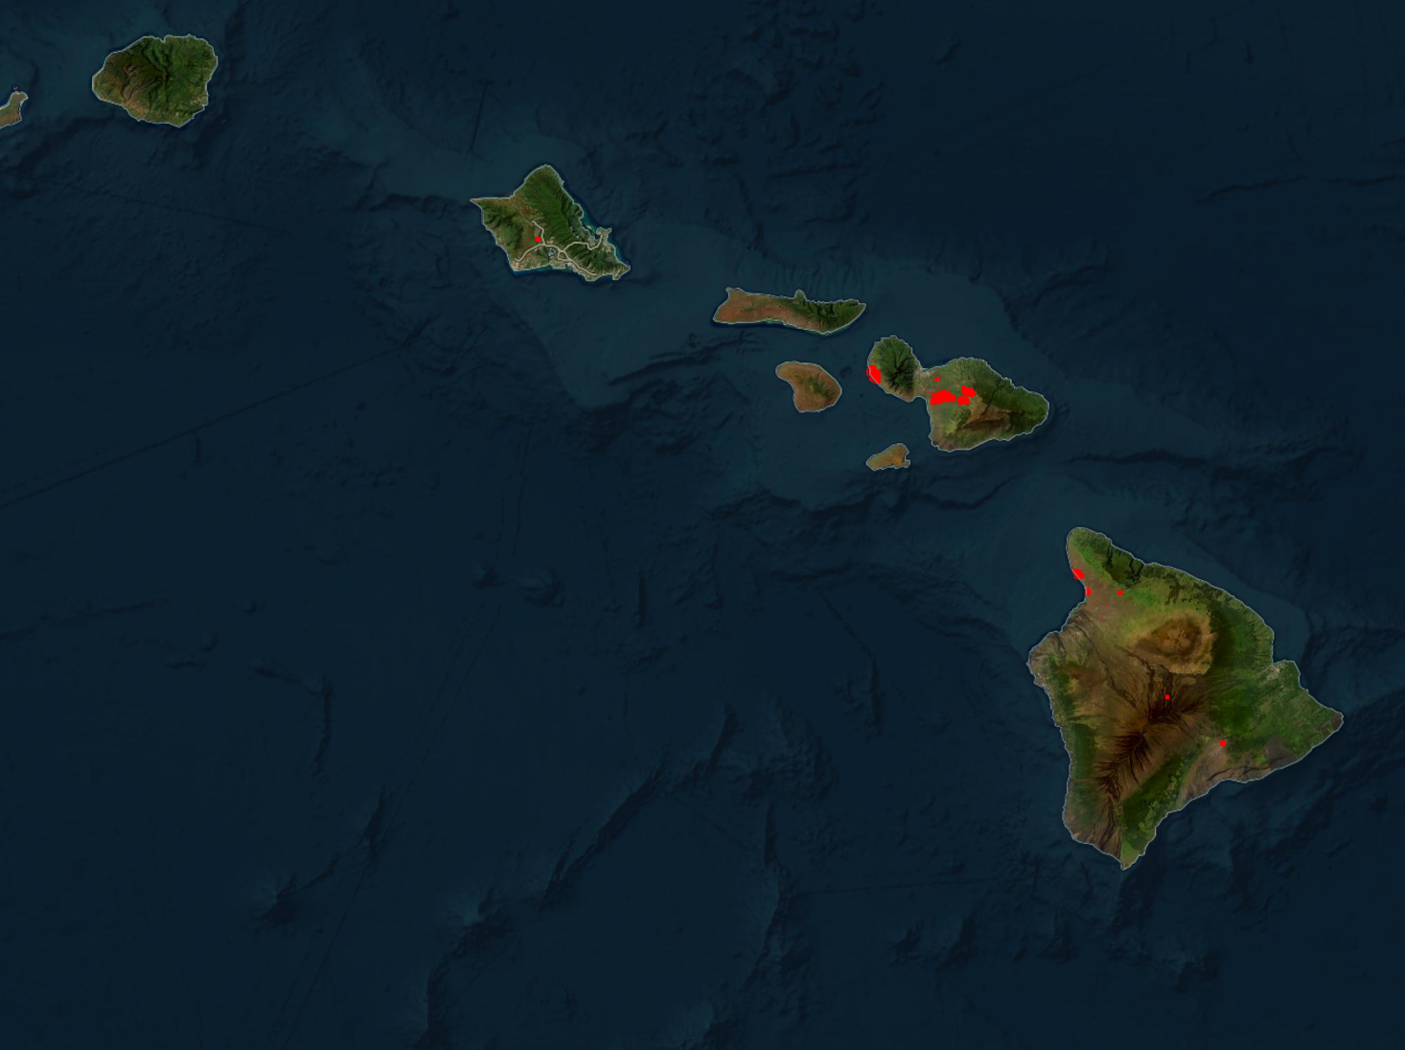
Lihue
Lihue
b
c
Hilo

Slide 2
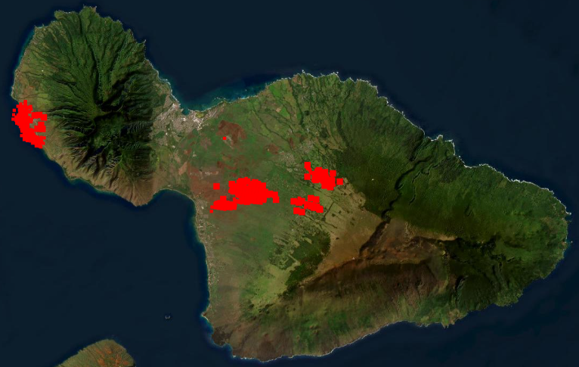
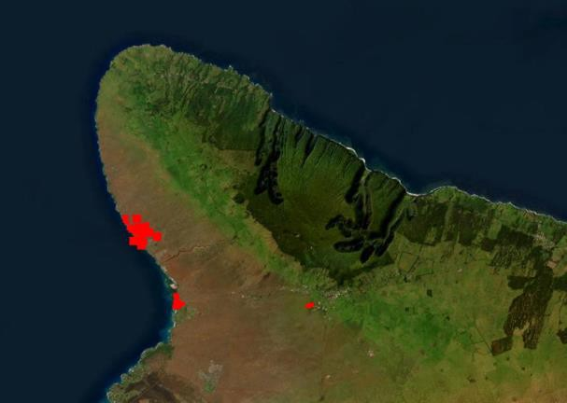
Kauai
Lihue
Oahu
Lahaina
Molokai
Maui
Lanai
Hawaii
Hilo

Slide 3
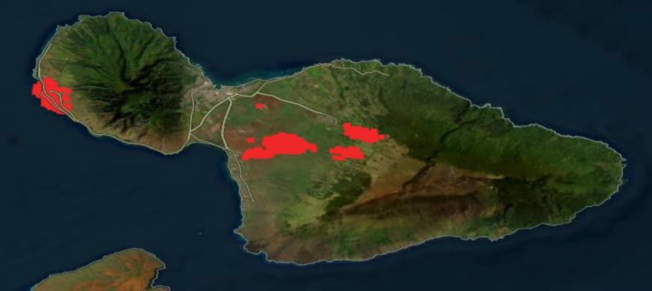

Slide 4
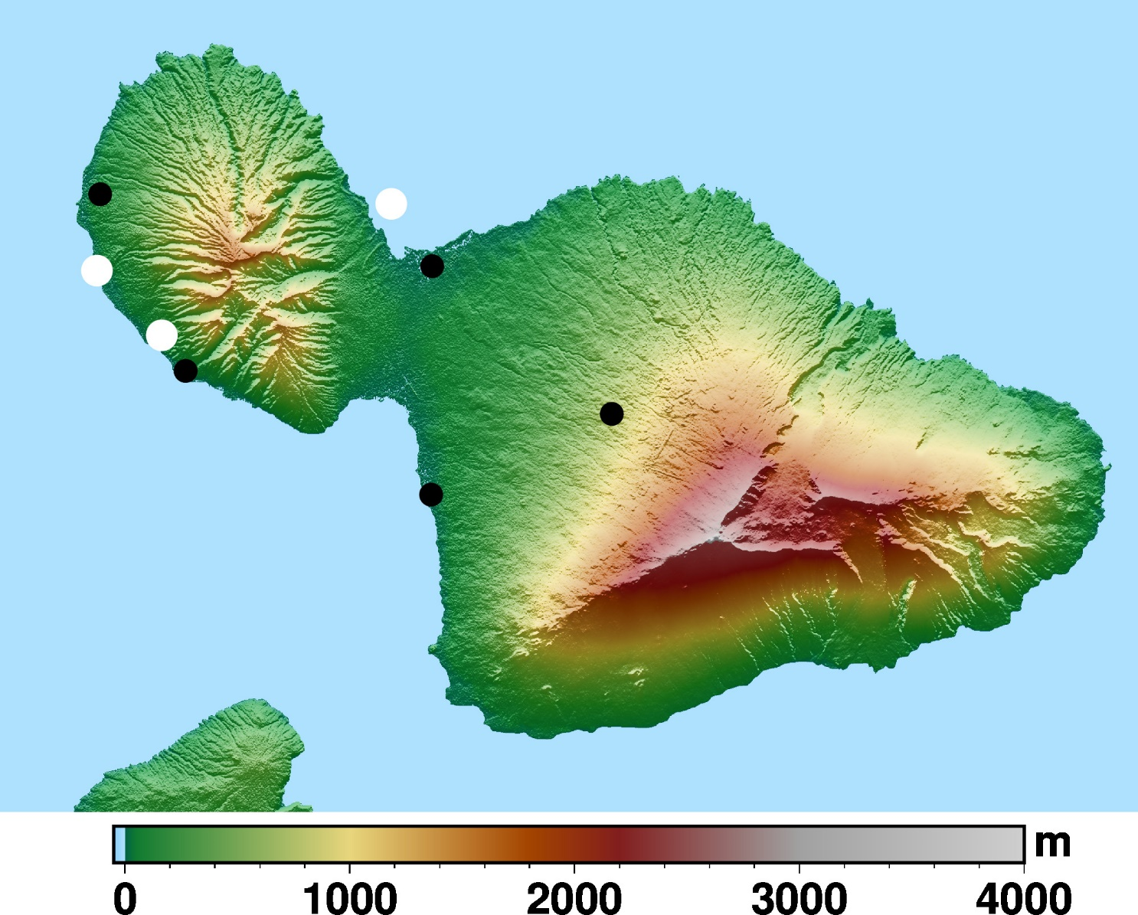
Kaanapali
West Maui
Mountains
Upstream
Kapalua
Kahului
Lahaina
Tempest
Olowalu
Kula
Olinda
Kihei
Haleakala

Slide 5
Kaanapali
West Maui
Mountains
Upstream
Kapalua airport
Kahului
Lahaina
Tempest
Olowalu
Kula
Olinda
Kihei
Haleakala

Slide 6
West Maui
Mountains
Kaanapali
Upstream
Kahului
Lahaina
Tempest
Olowalu
Kula
Kihei
Haleakala

Slide 7
Kauai
Lihue
Oahu
Lahaina
Molokai
Maui
Lanai
Hawaii
Hilo

Slide 8
Kaanapali
West Maui
Mountains
Upstream
Kapalua
Kahului
Lahaina
Tempest
Olowalu
Kula
Maalaea
Olinda
Kihei
Haleakala
Wailea

Slide 9
